Slide 1

IBM OpenPages AI-Enabled Data Breach Incident & Response Management
Notes:
This presentation describes the organizational need for a fully integrated governance, risk, and compliance (GRC) platform. It presents an overview of IBM OpenPages and how this solution meets the demands of constantly evolving regulations.
OpenPages is an artificial intelligence (AI)-driven, highly scalable GRC solution that runs on-premises, on any cloud, and can run alongside IBM Cloud Pak for Data. OpenPages helps centralize siloed risk management functions within a single environment to help clients identify, manage, monitor and report on risk and regulatory compliance… especially in today’s changing business landscape.
Clients can use OpenPages to prepare for the future with an extensible, fully configurable, integrated enterprise risk management solution that scales to tens of thousands of users.

Slide 2

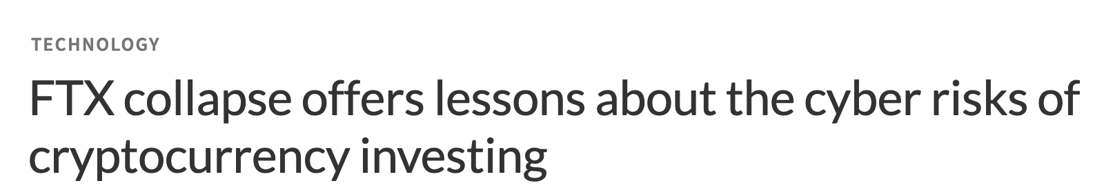


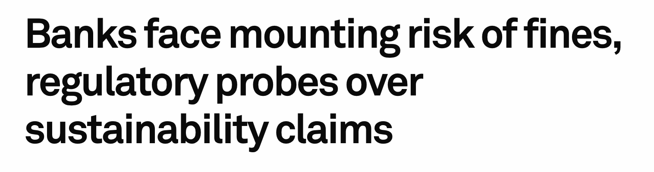
Lack of GRC processes lead to legal, financial, & reputational damage
“The potential costs of non-compliance are staggering. Organizations lose an average of $5.87 Million in revenue due to a single non-compliance event.”
- Globalscape study
Notes:
Governance, risk and compliance (GRC) functions, and failures in those functions, have rocketed to the top of company’s and organization’s agendas.
This can be seen in examples on this slide that include the following:
The recent massive control failures at companies like FTX globally.
The woeful risk and vendor risk management missteps at banks like Silicon Valley Bank (SVB) and Signature Bank in the United States, and more.
The systemic misconduct by brokers at a division of Comm Bank and mistreatment of the bank’s customers in Australia.
The potential costs of non-compliance are staggering and extend far beyond simple fines. Organizations lose an average of $5.87 million in revenue due to a single non-compliance event.
The total cost of non-compliance exceeds $14 Million and is a result of the following causes:
Fines, penalties, and other fees
Business disruption
Revenue loss
Productivity loss
Reputation damage
As a result, getting the whole organization engaged to shift culture to raise risk awareness is critical. Essentially… risk is everyone’s business.
Sources:
Globalscape study: https://static.fortra.com/globalscape/pdfs/guides/gs-true-cost-of-compliance-data-protection-regulations-gd.pdf#page=12
FTX collapse offers lessons about the cyber risks of cryptocurrency investing:
https://www.npr.org/2022/12/02/1140260100/ftx-collapse-offers-lessons-about-the-cyber-risks-of-cryptocurrency-investing
IT Leaders Reassess Vendor Risks After Silicon Valley Bank Collapse:
https://www.wsj.com/articles/it-leaders-reassess-vendor-risks-after-silicon-valley-bank-collapse-3acbab51
CommSec and AUSIEX hit with largest ever penalty for market integrity compliance failures:
https://www.businessnewsaustralia.com/articles/commsec-and-ausiex-hit-with-largest-ever-penalty-for-market-integrity-compliance-failures.html
Banks face mounting risk of fines, regulatory probes over sustainability claims:
https://www.spglobal.com/marketintelligence/en/news-insights/latest-news-headlines/banks-face-mounting-risk-of-fines-regulatory-probes-over-sustainability-claims-74385257
IDC PlanScape: Future of Trust — Implementing Automated Compliance Management for Better Efficacy and Efficiency Sept 2022: https://www.idc.com/getdoc.jsp?containerId=US49617722
https://medium.com/analysts-corner/data-quality-governance-and-compliance-cad6d8b132dd
Global anti-money laundering fines surge 50%:
https://www.ft.com/content/7a4821e6-96f1-475c-ae55-6401e402061f
Coinbase hit with $50m fine for “significant” compliance failures:
https://www.fintechfutures.com/2023/01/coinbase-hit-with-50m-fine-for-significant-compliance-failures/
https://www.forbes.com/sites/jonathankeane/2021/01/05/italian-court-finds-deliveroo-rating-algorithm-was-unfair-to-riders
https://english.rekenkamer.nl/publications/reports/2022/05/18/an-audit-of-9-algorithms-used-by-the-dutch-government
https://www-engadget-com.cdn.ampproject.org/c/s/www.engadget.com/amp/uk-police-fail-to-use-facial-recognition-ethically-and-legally-researchers-say-082039619.html
https://algorithmwatch.org/en/austrias-employment-agency-ams-rolls-out-discriminatory-algorithm/
https://www.foxglove.org.uk/2020/08/17/we-put-a-stop-to-the-a-level-grading-algorithm/
https://www.theverge.com/tldr/2020/11/3/21547392/ai-camera-operator-football-bald-head-soccer-mistakes

Slide 3
Sanctions Under Indonesia’s Personal Data Protection (PDP) Law
→
Administrative Sanctions
up to 2% of annual revenue
Orders to delete personal data.
Criminal Sanctions (Individual)
Imprisonment — up to 6 years
Fines — up to IDR 6 billion
Criminal Sanctions (Corporate)
Corporate fines (in addition to individual liability)
Asset freezes
Revocation of business licenses

Slide 4

More than following rules Safeguarding your identity, your data, your tomorrow

Slide 5
Challenges test us. Actions define us.
↓
Challenge by PDP
IBM actions
01
Breach Notification & Incident Response
Data breaches must be documented, registered and reported within 72 hours.
Provides incident and issue management modules—you can register data breaches, track mitigation steps, escalate automatically, and generate compliance-ready breach reports to regulators and affected individuals.
02
Risks Management & Privacy Impact Assessments (DPIA/PIA)
Requires proactive risk assessment for high-risk processing.
Includes automated risk assessment workflows, configurable privacy impact assessment, and AI-driven risk scoring. This supports early identification and mitigation of risks in personal-data processing.

Slide 6
AI for risk and compliance has arrived!
^{2.5x}
Both AI adoption and AI capabilities in organizations have more than doubled since 2017.
^{85%} of advanced adopters are reducing operating costs with AI.
Notes:
Artificial intelligence (AI) has become an essential tool in today's business world and its revolutionizing risk and compliance functions. AI-powered risk and compliance solutions can help businesses automate routine tasks, reduce response times, and improve regulator interaction.
Businesses large and small are embracing an AI-first approach (AI+) that encompasses prediction, automation, and machine learning. Both AI adoption and AI capabilities in organizations have more than doubled since 2017. And budget allocations for AI as part of a digital transformation strategy have grown from 5% in 2018 to 52% in 2022.
AI technologies like large language models (LLMs) and generative AI (used by tools like ChatGPT, Bard, watsonx Assistant, and more) are evidence of the rising awareness of the power, value, and usefulness of AI. Also, AI is now applied to key risk and compliance functions and processes.
Sources:
Mckinsey study: “The state of AI in 2022 — and a half decade in review” December 6, 2022 | Survey https://www.mckinsey.com/capabilities/quantumblack/our-insights/the-state-of-ai-in-2022-and-a-half-decade-in-review#
IBM IBV study: Goehring, Brian and Anthony Marshall. “The business value of AI.” IBM Institute for Business Value. November 2020. https://ibm.co/ai-value-pandemic

Slide 7
The AI for risk and compliance advantage
Promote a culture of risk recognition and compliance awareness
Increase data quality and consistency
Enrich, guide, and help the user to provide the right information
Automate processes and optimize employee productivity and accuracy
Notes:
Artificial intelligence (AI) for risk and compliance is here – and clients can use it today in the following ways:
Embedding AI in governance, risk, and compliance (GRC) programs increases employee engagement and drives inclusion of employees, regardless of their expertise level or native language. All these benefits help clients build on, and promote, a heathy and inclusive risk-aware culture.
AI improves risk and compliance data quality and consistency. And, as a result, increases client’s confidence in their risk and compliance conclusions, decisions, and interactions with regulators and other constituencies.
AI improves user and employee experience with GRC technology. AI powered chat enriches, guides, and provides context to employees, 24 hours a day.
And finally, AI automates processes, especially repetitive data sensitive tasks – and this in turn drives employee engagement, productivity, and the overall accuracy of GRC programs.

Slide 8


What is IBM OpenPages with Watson?
Our solution is an AI-driven, highly scalable governance, risk, and compliance (GRC) platform supporting eleven solutions.
OpenPages enables organizations to centralize siloed risk management functions to identify, manage, monitor, and report on risk and regulatory compliance using the following key features:
Automate workflows: Automate GRC processes in minutes and enhance time to value with configurable workflows and a calculation engine accessible through the UI without the need for coding experience.
Expertise with AI: translations across 50+ languages, obtain 24/7 support with a GRC virtual assistant, promote accuracy and efficiency in incident reporting with AI relevant classifications.
Predictive insights: Provide insight into the state of risk across the organization with embedded business intelligence for self-service data exploration and insights.
Third-party integrations: Achieve data integrations with IBM AppConnect and with comprehensive REST APIs that integrate GRC processes with third-party connectors.
Zero-training UI: Drive GRC adoption for all three lines of the business with a modern, task-focused UI to complete tasks.
Environmental, Social & Governance
Internal
Audit
IT Governance
Third Party
Risk
Regulatory Compliance
Operational Risk
OpenPages Platform
Model Risk Governance
Policy Compliance
Data Privacy
Business Continuity
Financial
Controls
8

Slide 9
Why IBM OpenPages with Watson?
Our Differentiation
Reduces Risk and Compliance Exposure
Avoid/reduce exposure to regulatory fines
Raise risk awareness across the organization
Connect employees to critical policies in their native language
Leverages IBM GRC Experience
Extensive success modernizing from legacy GRC platforms
GRC focused platform on the market for over 20 years
World Class Guidance from GRC veterans
Increases Operational Efficiency
Focus on Configuration versus Customization
Adapts to your existing methodologies
Seamless integration with legacy and bespoke GRC tools
Our solution is an AI-driven, highly scalable governance, risk, and compliance (GRC) platform supporting eleven solutions.
Environmental, Social & Governance
Internal
Audit
IT Governance
Third Party
Risk
Regulatory Compliance
Operational Risk
OpenPages Platform
Model Risk Governance
Policy Compliance
Data Privacy
Business Continuity
Financial
Controls
9

Slide 10







AI integrations help to radically improve user decision making and accelerate customer time to value
BYO Model
Assistant
Classification
Infused AI
Association
Summarization
Translation
Tagging
Notes:
IBM artificial intelligence (AI) capabilities have been brought to bear – specifically, capabilities that are radically helping improve decision making and accelerating clients time to value.
As part of IBM’s Data and AI portfolio, IBM OpenPages integrates AI technologies in support of governance, risk, and compliance (GRC) use cases including classification, translation, and detection of drift and bias in AI models.
After interruptions in day-to-day operations due to COVID-19 (for example, supply chain issues, or increased cyberattacks), IBM recognizes that clients are striving to become more predictive in anticipating and mitigating risk. IBM also uses AI to automatically identify and tag related information across the OpenPages data model to provide deeper insights to underlying risks. This focus also includes opportunities to improve control effectiveness through on-going monitoring and automated evidence so that risks can be identified in real-time as opposed to after an issue or a loss event.
As several regulatory agencies have now proposed model governance legislation, OpenPages is focused on helping organizations facilitate AI adoption through process governance that helps to ensure trustworthy AI. OpenPages model risk governance is an ongoing area of investment that helps clients ensure trust, transparency, and compliance in support of effective adoption of AI models.

Slide 11
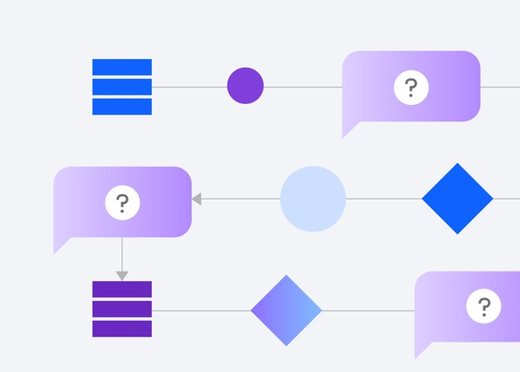
Operationalizing AI with confidence
Organizations struggle with:
Clarity, monitoring, & cataloging
Transparent & explainable workflows
Scale and automation
11
Notes:
Operationalizing artificial intelligence (AI) can be a challenge for organizations. Specifically, organizations struggle with the issues shown on this self-explanatory slide.
For example, IBM has a client who struggled with data quality when collecting and analyzing loss events, so much so that their regulator threated serious action. This regional bank used IBM’s risk and compliance AI to provide suggestions (with an accuracy confidence rating) to classify these events, assisting those end users who were not experts – giving transparency and confidence to the whole process.
Looking at another example, IBM has a client with over 2500 auditors located around the world. This client deployed IBM’s platform with its AI-enabled chatbot to provide reliable and repeatable 24-hour guidance to these auditors, enabling them to scale with confidence.
IBM has seen the power of AI to make client’s risk and compliance functions more reliable, efficient, and repeatable. However, there is a trust component that is also critical.

Slide 12


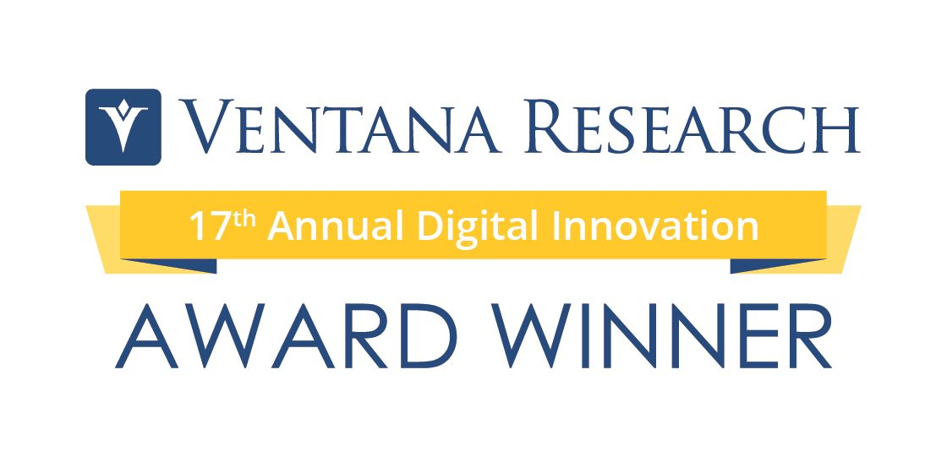


Award winning market leader
2024
Category “Leader” in ALL seven (7) Quadrant categories
IDC 2024 SaaS CSAT Award for Financial Governance, Risk & Compliance
IBM for watsonx.governance award for software provider that best exemplifies innovation in any use or application of AI across the business and/or IT.
2022
2023
“Leader” in IDC’s new Third Party Risk Management Vendor Quadrant study.
“Leader” in Market and Vendor Landscape reports for Digitalization and Control Solutions, 2022 and Operational Risk and Conduct Risk, 2022.
RiskTech 100: IBM RegTech recognized as top 20 vendor.
Top “Leader” for Chartis RiskTech Quadrant for Enterprise GRC Solutions, 2023.
Category “Leader” for Chartis Model Risk Management, 2023.
RiskTech 100: IBM RegTech recognized as top 20 vendor
Top “Leader” in IDC’s MarketScape: Worldwide AI Governance Platforms 2023.
“Strong Performer” in Q4 2023 for The Forrester Wave: Governance, Risk, and Compliance Platforms.
Top vendor placement for current offering functionality.
Notes:
This self-explanatory slides shows how IBM OpenPages is a market leader in the governance, risk, and compliance (GRC) space:
Specifically, OpenPages has earned Category Leader Status in all segments including the following:
Enterprise Governance, Risk Management, and Compliance (EGRC)
Operational risk
Conduct risk and controls
Internal audit management
Third-party risk management (3PRM)
Model risk management (MRM)
IT risk management (ITRM)
Sources:
Gartner 2021: https://www.ibm.com/account/reg/us-en/signup?formid=urx-51236
Chartis 2021: https://www.chartis-research.com/grc-and-operational-risk/governance-risk-management-and-compliance-grc/7835781/grc-solutions-2021-market-update-and-vendor-landscape
Chartis 2022: https://www.chartis-research.com/grc-and-operational-risk/operational-risk/7946723/operational-risk-and-conduct-risk-and-control-solutions-2022-market-and-vendor-landscape
Chartis 2023: https://www.chartis-research.com/grc-and-operational-risk/governance-risk-management-and-compliance-grc/7946813/enterprise-grc-and-internal-audit-solutions-2023-market-update-and-vendor-landscape

Slide 13
IBM OpenPages delivers value rapidly
IBM commissioned Forrester Consulting to conduct a Total Economic Impact study of IBM OpenPages
Return on investment
Benefits over three years
Reduction in risk management effort
Payback period
249%
$3M
$2M
<6 Months
Notes:
IBM commissioned Forrester Consulting to conduct the Total Economic Impact (TEI) study that evaluated the financial impact of IBM OpenPages on organizations.
IBM OpenPages delivers 249% ROI to clients. IBM recently commissioned Forrester Consulting to conduct the Total Economic Impact (TEI) study that evaluated the financial impact of IBM OpenPages on organizations. Learn how IBM OpenPages, an AI-driven integrated governance, risk and compliance (GRC) platform can cut license and implementation costs and drive savings due to regulatory fine and penalty avoidance, reduced risk management effort, and legacy system costs.
The cost savings and business benefits enabled by IBM OpenPages, over three years, include the following:
249% in return on investment (ROI)
$3 million in benefits
$2 million in reduction in risk management effort
Blog: https://www.ibm.com/blogs/watson/2020/12/ibm-openpages-with-watson-can-deliver-a-218-return-on-investment-finds-forrester-study/
Full study: https://www.ibm.com/account/reg/us-en/signup?formid=urx-48215

Slide 14
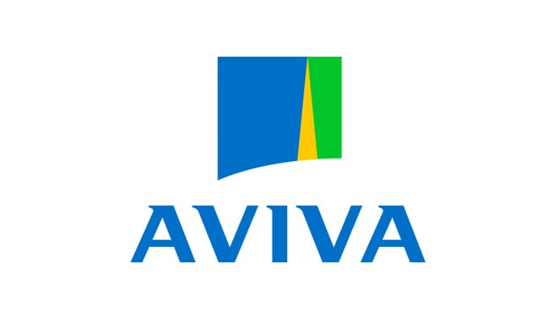
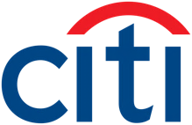

Client use cases for IBM OpenPages
Internal audit use case
Citi transformed critical internal audit processes by giving auditors access to tooling that analyzes the control definitions and scores them based upon the 5 “W”s.
Operational risk management use case
Aviva has modernized its operational risk management solution with the help of new IBM OpenPages product enhancements, opening up GRC capabilities to optimize the user experience.
Enterprise risk management
By using OpenPages to support Audit, Risk and Control activities, GM has gained a more granular (and at the same time enterprise-wide) view of potential threats to its business — empowering the company to control and mitigate risk, as well as prevent losses and reputational damage.
Read the blog
Read the blog
Read client story
Notes:
This slide details some IBM OpenPages clients and their use cases.
Citi
With one of the largest corporate audit departments in the world, Citi has 2500 auditors going through documentation reviews and risk assessments. Citi needed to plan and scope audits more effectively so they started building a practice called “audit of the future”, where cutting edge machine learning (ML), natural language processing (NLP), and advanced analytics solutions (available through IBM Watson Discovery, IBM Cloud Pak for Data, and IBM OpenPages) will forever transform the daily work of the bank’s 2500 auditors.
Citi’s project focusses on how to bring ML and artificial intelligence (AI) into the full audit lifecycle, to help find anomalies within business monitoring, then plan and scope audits more effectively using all the new insights.
Citi geared up to give auditors “superpowers” with greater detection capabilities and “beefed-up” data-driven insights — all within a unified platform that could enhance stakeholder engagement and collaboration.
IBM helped Citi save hundreds of thousands of billable hours each month, reducing the processing time for the thousands of transcripts between their agents and customers.
Key use cases for Citi include the following:
The first use case gave auditors access to tooling that analyzes their control definitions and scored them based upon the 5 “W”s (who, what, when, how, and why).
A second use case was designed to help auditors tap into IBM Watson Discovery to save time processing thousands of transcripts between agents and customers monthly.
A third use case brings IBM watsonx Assistant to the task of assisting auditors with identifying relevant content from within hundreds of pages of audit manuals.
For more details, see the following blog post: https://www.ibm.com/blog/citi-transforms-critical-internal-audit-with-machine-learning-nlp-and-ai/.
Aviva
For more than 325 years, Aviva plc has helped its customers enjoy peace of mind. Today, as one of the largest savings, retirement, and insurance businesses in the United Kingdom, Aviva helps more than 34 million customers manage the risks of everyday life. Essential to their company strategy is enhancing the user experience for their internal customers who must adhere to Aviva's governance, risk, and compliance (GRC) company mandates.
For more details, see the following blog post: https://www.ibm.com/cloud/blog/how-aviva-modernizes-operational-risk-management-for-a-more-engaging-user-experience
General Motors (GM) GM relied on four separate systems to support its Audit, Risk, and Control activities… which made it difficult to gain a real-time view of and understand relationships between risks, controls and issues across the company.
GM is unifying these activities with IBM OpenPages and experiencing the following results:
Enabled rapid analytics with a single source of truth for Audit, Risk, and Control data
Increased consistency by standardizing structures and hierarchies for process, risk, controls, and issues
Decreased costs for licensing and maintenance by consolidating four systems to one
For more details, see: https://www.ibm.com/downloads/cas/LV7Z3BE8.
Sources:
https://www.ibm.com/blogs/journey-to-ai/2021/07/citi-transforms-critical-internal-audit-with-machine-learning-nlp-and-ai/
https://www.ibm.com/cloud/blog/how-aviva-modernizes-operational-risk-management-for-a-more-engaging-user-experience
https://mediacenter.ibm.com/media/Aviva+%2B+IBMA+Rethinking+the+user+experience+of+IBM+OpenPages+with+Watson/1_wwxuvmt3
https://www.ibm.com/downloads/cas/LV7Z3BE8

Slide 15
Notes:
This slide is self-explanatory and requires no speaker notes.

